Slide 1

Intelligenza artificiale, benefici per l’IT e per la società
Mauro Colombo
24 Ottobre 2019

Slide 2

Topics
1
Quali sono I fattori “esterni” che accellerano l’adozione?
2
Quale e’ il punto di vista HPE: soluzioni AI dall’edge al cloud
3
Soluzioni AI per le infrastrutture IT: HPE Infosight
4
Soluzioni AI per la societa’: ambiti e casi di applicazione
5
Quale strategia e soluzione adottare?
Notes:
(Read off the agenda for this session)
(Transition to next slide: so Why AI and why should you care?)

Slide 3

Data can transform the way we live and work
Unlocked through AI and advanced analytics
Notes:
Enterprises everywhere want to grow, to find new revenue streams, become more efficient and gain competitive edge.
They’re starting to realize that the data generated by their business is not a burden, but a potent raw material. In that data is the vital insights that can transform their businesses – uncovered through AI and advanced analytics tools.
More efficient operations
More productive factories
New businesses
And companies know they can’t afford not to grasp this opportunity. The companies that do could leapfrog them and race away.

Slide 4

Artificial Intelligence requires data, a lot of data!
Digitization of analog reality
40,000
petabytes a day*
10 million connected
cars by 2020
Human interaction data
4 petabytes a day
Per-day posting to Facebook across 2 billion users
(2017)
2MB per active user
Structured data
40 petabytes
Walmart’s transaction
database (2017)
* Driver assistance systems only
Notes:
AI requires huge amounts of data, which can come from multiple data sources.
AI demands data. Deep Learning training is impossible without it, and can’t improve without additional data. As AI moves into production, the quantity of data will only increase. For instance, IoT sensors will collect massive amounts of data for predictive maintenance and yield improvement in Manufacturing. Autonomous vehicle fleets gather petabytes of data every year to improve driving algorithm.
A data strategy is required:
Collect: the more value you can extract from data, the more resources you should commit to retaining it in full fidelity. What you think is worthless today could be a priceless training set tomorrow.
Curate: adding metadata -tagging your data, is a critical step. If you don’t know what you have and where it is, you can never use it.
Federate across your business. You don’t need to copy the data (even if it’s feasible and permitted); but you need to share the metadata among all your business units. It’s when everyone knows all the data available, they can do new and amazing things.
But HPE understands that even when you have your data strategy in place, what’s next – actually using that data – isn’t easy.
__________
This slide shows examples of how not just he amount of data is changing, but that we have new sources, new things we need to do with that data and less and less time to do those things.
Once social media had taken off, we started to talk about the vast amounts of data that was being processed. It was way more than the structured data we’d processed up to that point.
For example, by May 2016, Facebook was processing 4 petabytes of data a day. That’s twice the entire Walmart transaction (structured) database, every day. While this is high, it’s actually only 2MB per active Facebook user.
However, we’re about to take another leap in magnitude in the amount of data we’ll be processing. For example, just one self-driving car will generate 4 terabytes of data a day (as the graphic on the right nicely shows). That’s just one car. There will be 10 million of them by 2020. And that’s just self-driving cars. We’ll be generating such levels of data from IoT sensors all over our “physical world”.
Why do much data? Because we are moving to an era where we sense reality. And, unlike structured data and social media data, reality is not digital. We need to create a digital version of our analog reality. That takes a lot of data (actually, the amount of data it generates is our choice – the higher the fidelity of our sensors the more data we generate. And our analysis is better if we have high fidelity sensors – so we will have a lot of data).
Walmart and Facebook in their own ways, are extracting huge value and monetizing their 2-4PB of data, (maybe even still scratching the surface) When someone figures out how to extract value from that 40kPB and the things they will be able to do, will seem like magic. To extract value – we need new architectures/techs to achieve that. Memory driven architectures, AI/ML, etc.
*This 40EB per day figure is for the driver assistance/autonomous driving sensory systems Most modern vehicles today already have more than 100 microprocessors handing the vehicle operational technology and all of that data is also thrown away save the check engine light codes.
Note: HPE’s working set is 19PB across 8,000 databases
[next: more on the data explosion and the compute gap]
Sources :
Car stats : Intel newsroom https://newsroom.intel.com/editorials/krzanich-the-future-of-automated-driving/
Walmart’s transaction database of 40 petabytes - Forbes article, Jan. 23, 2017 https://www.forbes.com/sites/bernardmarr/2017/01/23/really-big-data-at-walmart-real-time-insights-from-their-40-petabyte-data-cloud/#524df6af6c10
Facebook: Brandwatch, Mar. 5, 2018 https://www.brandwatch.com/blog/47-facebook-statistics/
Number of self-driving cars : Business Insider, June 2016 https://www.businessinsider.com/report-10-million-self-driving-cars-will-be-on-the-road-by-2020-2015-5-6
Car stats : Intel

Slide 5
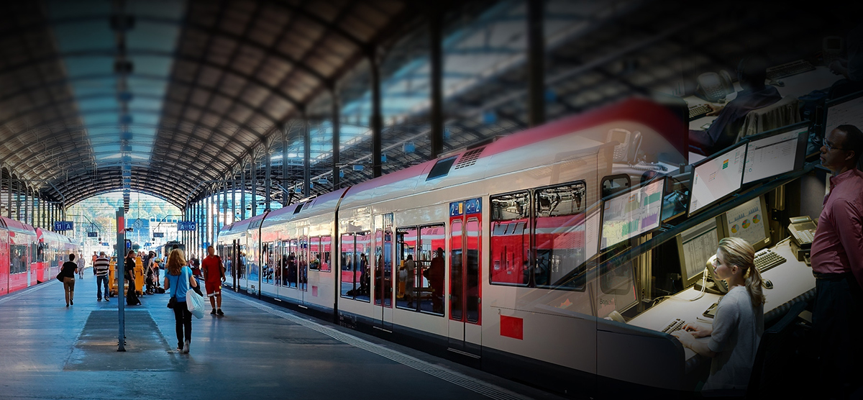
What you need to do defines what you have to do
How do you prepare and integrate data for advanced analytics ?
How long do you have to take action?
Edge
Cloud
Where is the data generated?
What are your business goals?
What do you have to do to put that data in
a form you can use?
What governance and security regulations do you need to comply with?
What does that data consist of?
Notes:
What you need to do, defines what you have to do:
Where is the data generated?
What does that data consist of? What do you have to do to put that data in a form you can use?
How long do you have to take action?
What governance and security regulations do you need to comply with?
What are your business goal?
The answers to those questions define where the data should live along the continuum from edge to cloud.
What you need to do with the data defines the analytics tools you need.
For example, you might have seconds to decide if an on-line transaction is fraudulent. The data is small. There’s time to use a cloud-based algorithm to decide if the transaction should be allowed.
If you’re designing a car, you’ve got months to gather and analyze petabytes of field data to improve the next model. The HPC cluster at the factory is the right place to do the analysis.
But if that car has to decide between hitting a wall or hitting a pedestrian, it’s different. The data from the sensors is large and the time to action has to be milliseconds. That analysis has to be done right there and right now. At the edge.

Slide 6
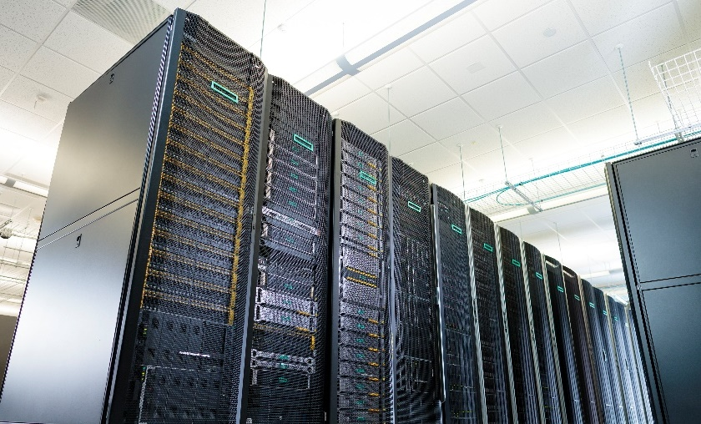
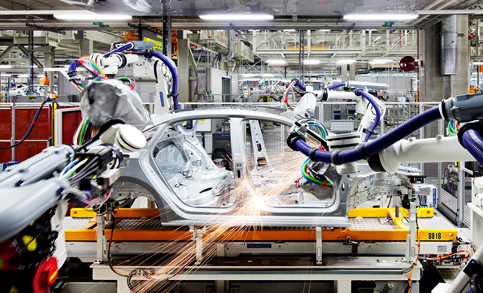







HPE helps “unlock your data with AI”
AI within
our products
AI for
business
AI for
the future
AI-driven Operations
Across edge to cloud infrastructure
Gain faster insights
with scalable AI solutions and services
Optimize infrastructure
with the latest AI technologies
Notes:
One of HPE ‘s goals is to help customers “Unlock your data with AI” from the edge to cloud…now and into the future
To do this, we need to look at our approach across three dimensions, specifically AI within our products, AI for our customers and AI for the future.
AI within our products
Perhaps the ultimate use of AI is to use AI to predict and solve problems automatically which we call enabling AI-driven operations (AI-Ops) across edge-to-cloud infrastructure. Two examples include 1) HPE InfoSight and 2) HPE Aruba Introspect. Both of these solutions improve productivity by transforming the data center management and support using embedded AI techniques.
AI for the Future
When you look to the far right column, we call out AI for the future…. think of Hewlett Packard labs and work their doing to create the latest HPE technologies and products. Examples include Dot Product Engine and Memory Driven Computing, the ultimate AI-friendly architecture.
AI for our customers
With our recent announcement we are focusing on the middle column, specifically AI for Business. Customers are faced with many challenges along their AI journey from getting started, the right tools and services, choosing the right infrastructure and navigated a vast partner ecosystem. We are extending our purpose-built AI portfolio, leveraging Pointnext advisory services to provide much needed advice and expertise, continuing to build on our partner ecosystem and developing optimized configurations. All of which is to help customers unlock their data to gain faster insights and deliver business outcomes.

Slide 7
Artificial Intelligence
Revolutionizes
Infrastructure Management
Notes:
It is a very exciting time to be in the AI industry.
The world has transformed dramatically in the last 5-10 years.
What seemed impossible is now commonplace. We talk to our devices, we trust self-driving cars. When technology is fully developed, it eases into the background.
Today, I am going to discuss how HPE has evolved Infrastructure Management using Artificial Intelligence, a product we developed called InfoSight.
Before, we dive into InfoSight. How has the field of AI evolved? What Powered this AI revolution? There are two reasons that allowed us to break out from the AI winter and incorporate AI into our businesses and our daily lives.

Slide 8

Artificial Intelligence applied to IT Infrastructures
Observing
Learn
Sense
Acting
Learning
HPE InfoSight
Act
Think
Predicting
Recommending
Notes:
And that is why we created InfoSight. AI-driven operations for infrastructure management.
InfoSight follows the same sense, think, act, and learn structure.
We began the AI journey over a decade ago by collecting data and building sensors into our infrastructure.
Our goal is to simplify IT operations so that your business can speed up the innovation cycle.

Slide 9
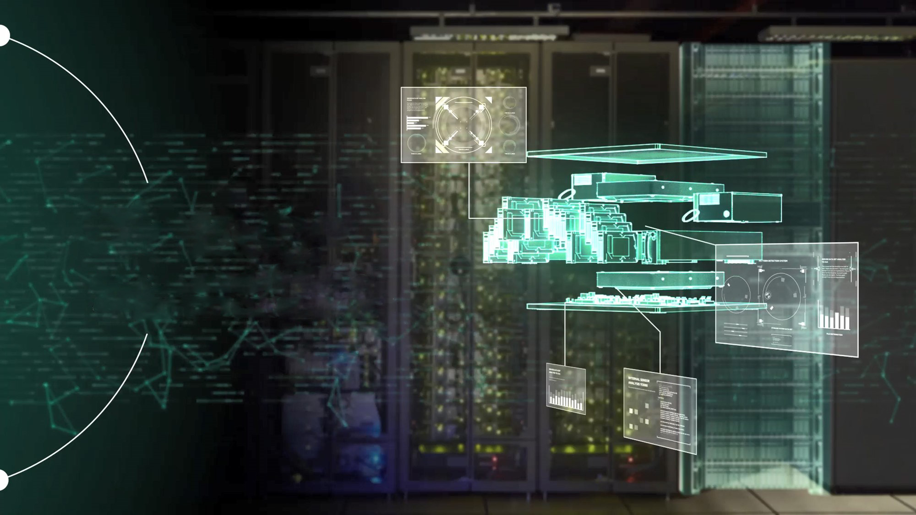
Observing
1000s of sensors in every system collected and analysed every second
Notes:
I spoke about the value of data earlier. Data is the foundation to executing on the vision of autonomous infrastructure.
We built sensors into our systems over a decade ago - We didn’t just focus on storage, but across the entire stack from storage to VM’s because infrastructure doesn’t operate in isolation.
Every second, millions of integrated sensors are capturing and analyzing the state of IT systems and the surrounding Infrastructure and sending this data back to our our global install base – which has over 300 trillion sensor data point.

Slide 10
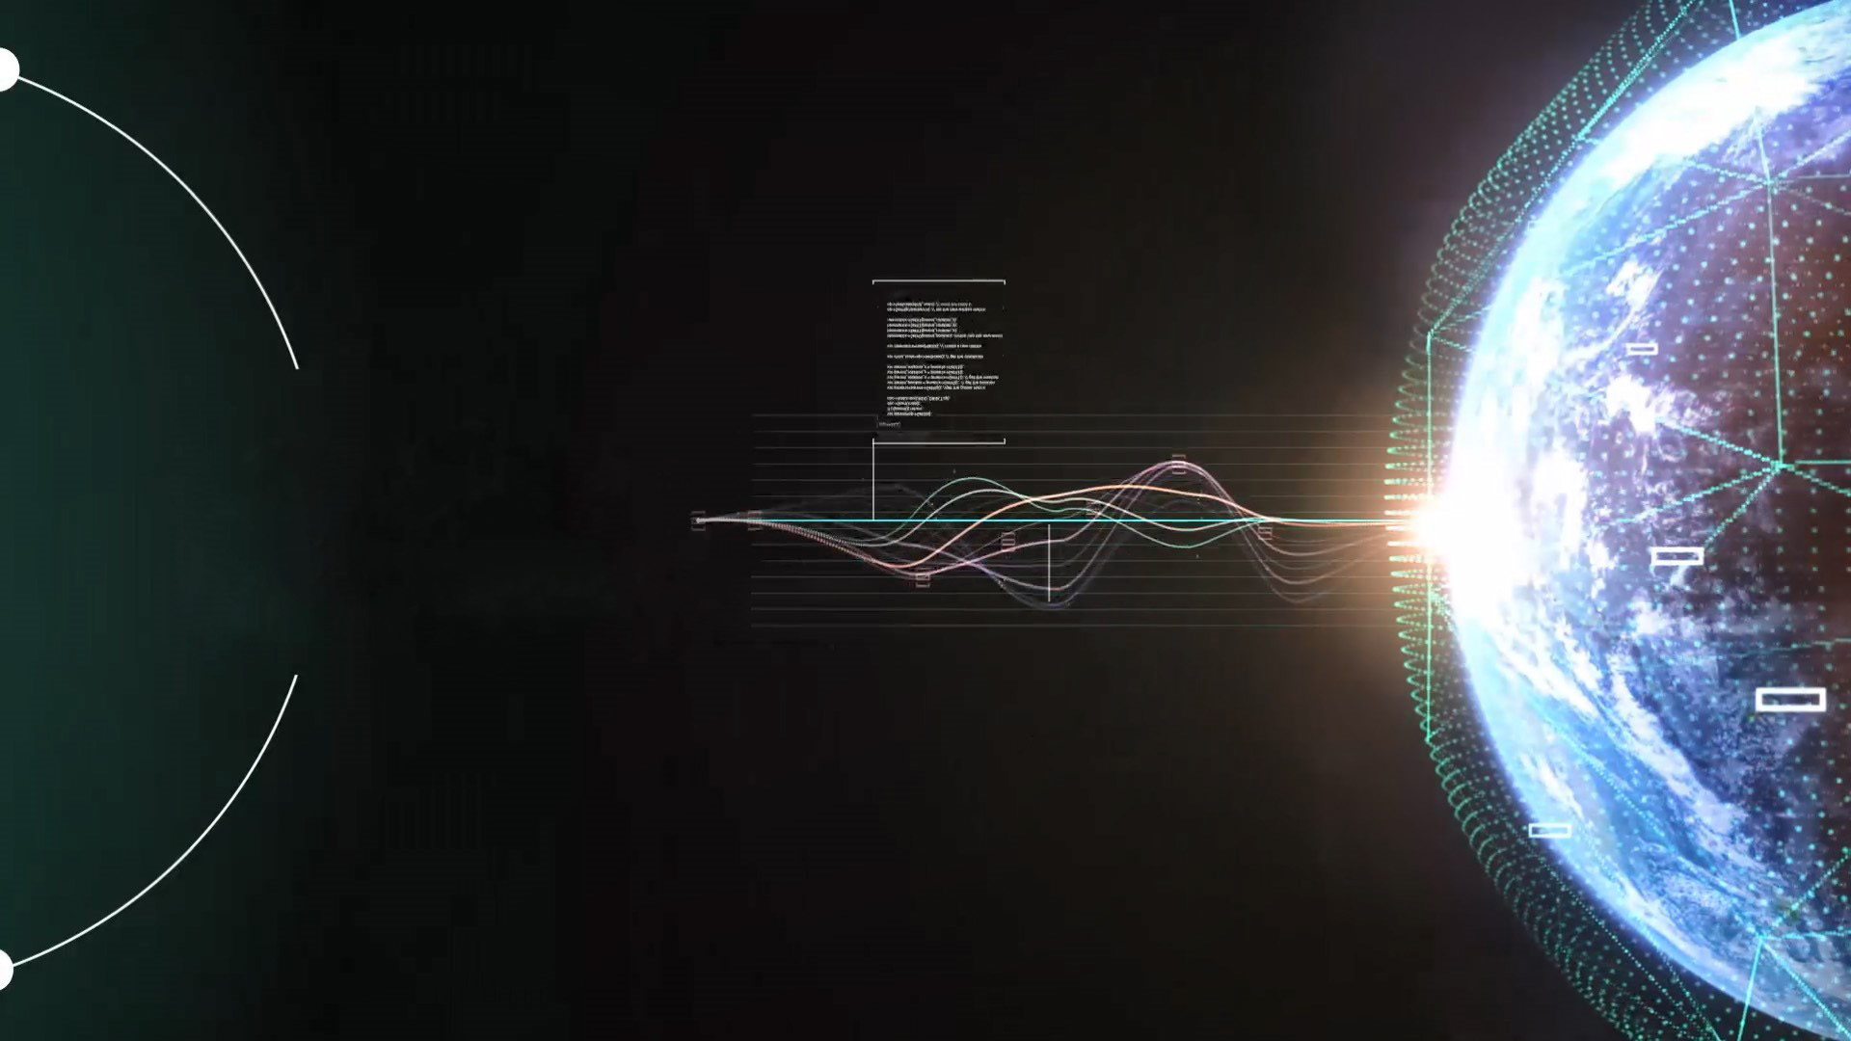
Learning
Advanced pattern recognition across >300 trillion sensor data points globally
Notes:
Infosight is constantly learning from the data captured by the sensors in order to determine what the ideal operating environment is for every workload and application.

Slide 11
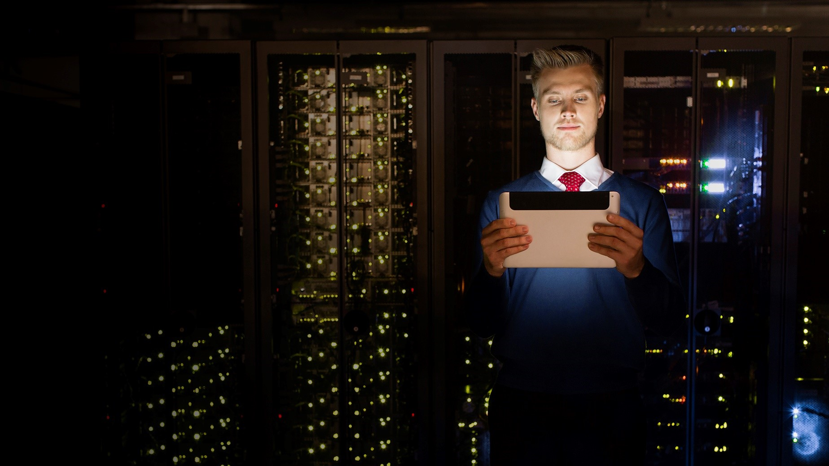

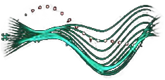
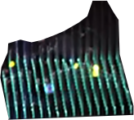


Predicting
Anticipating problems and improving application performance across all infrastructure layers
alert
Susceptible to
Hypervisor issue
Notes:
Using machine learning and deep learning techniques, InfoSight is able to predict and identify abnormal behavior and improve performance across all infrastructure layers.

Slide 12
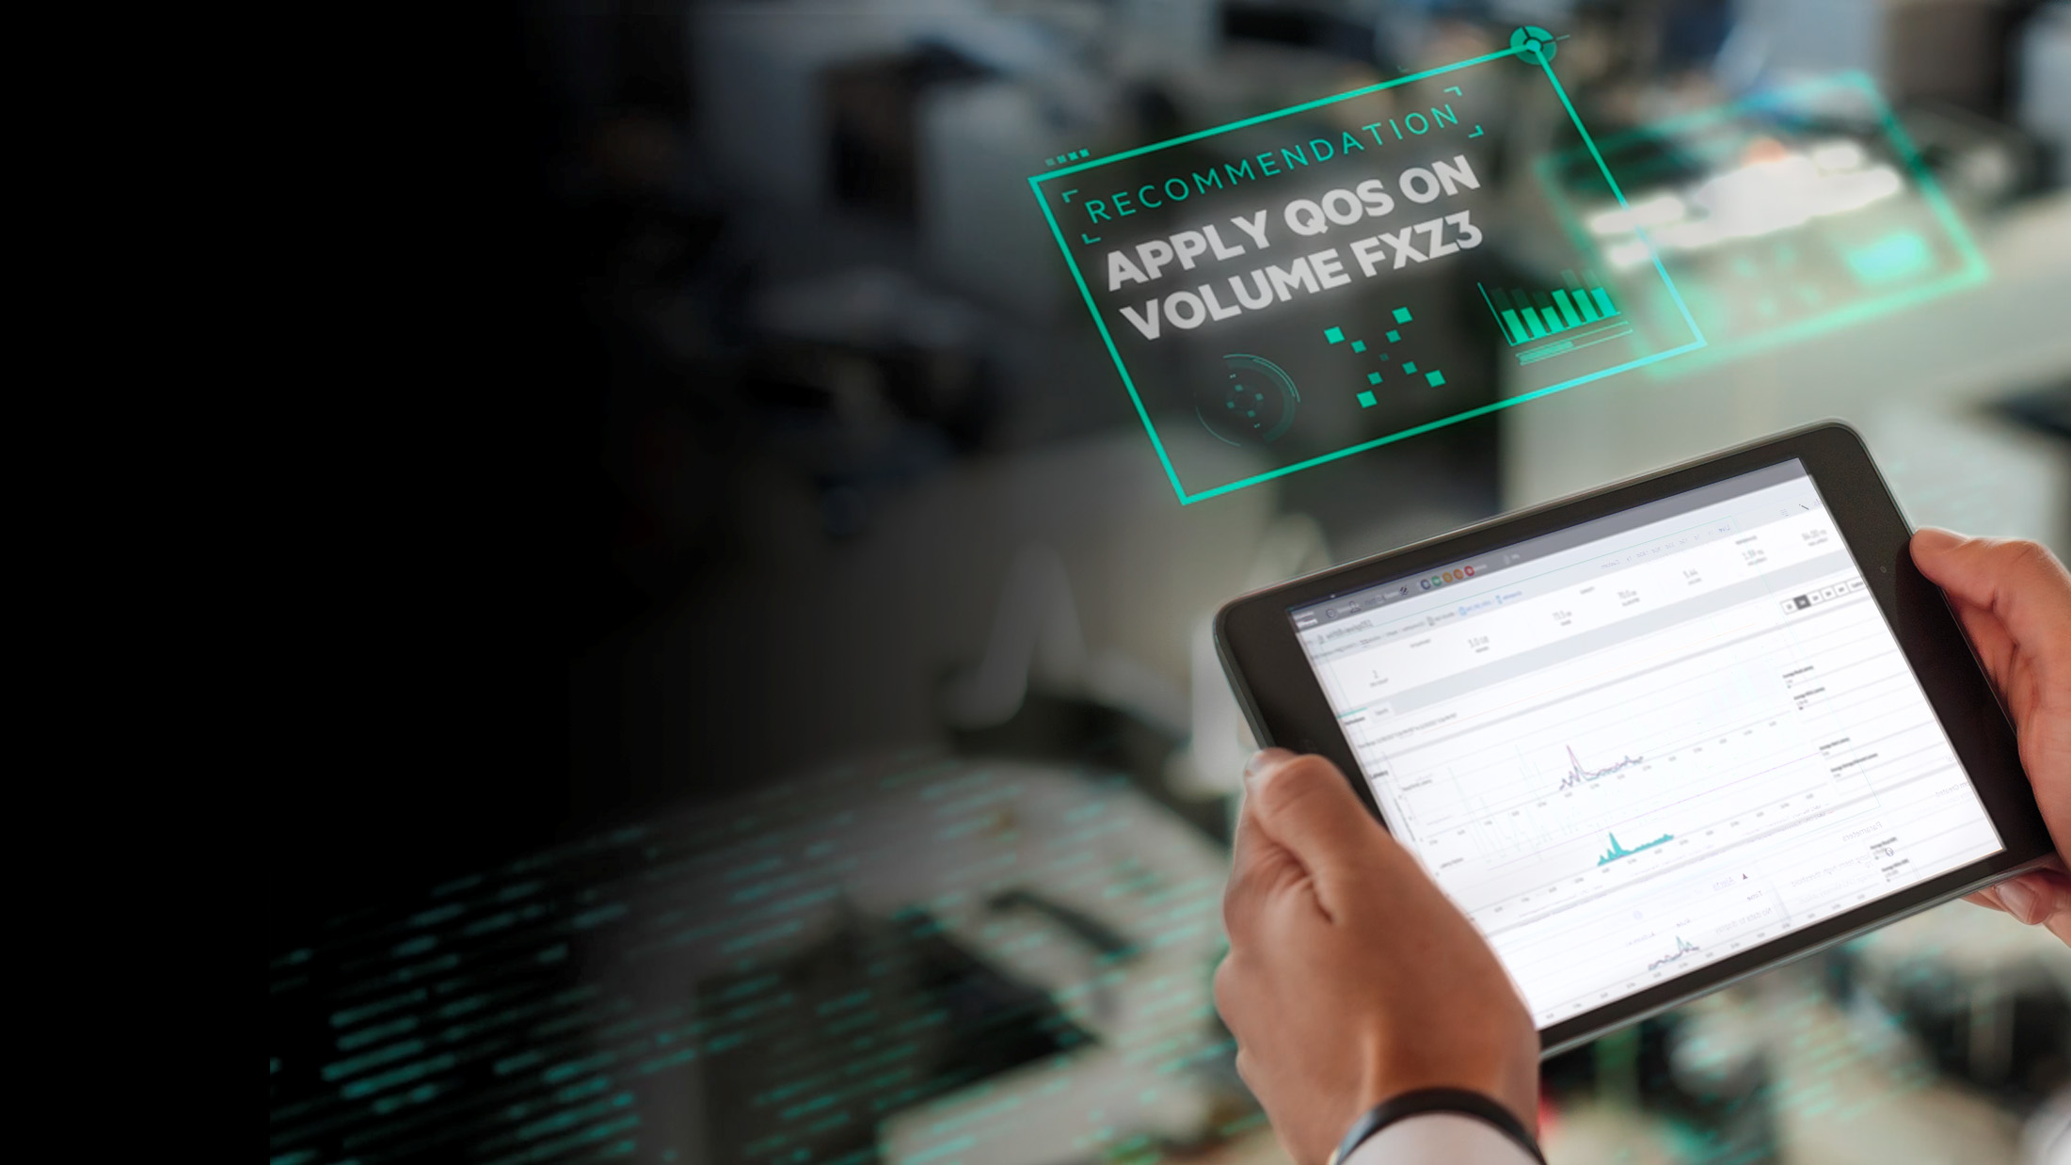
Recommending
Intelligent decisions that prevent issues, improve performance and optimize resources.
Notes:
Going one step further, InfoSight recommends how to improve application performance. We are not just predicting and anticipating problems, but making recommendations to optimize your infrastructure
These recommendations are not generic, they are specific to your systems – your environment. It’s automated and personalized.

Slide 13

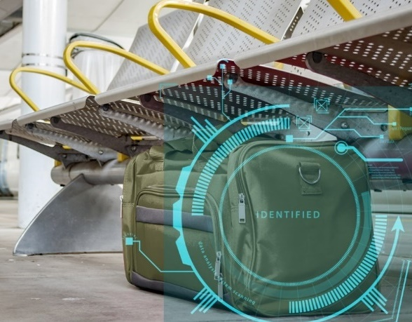
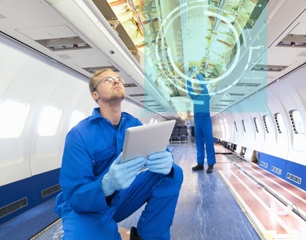
Portfolio of use case specific solutions
Use Cases / Vertical Applications:
Speech To Text Natural Language Processing
  Speech to Text
  Biometric search
  Live Call monitoring
Surveillance using
video analytics
  Facial recognition
  Queue monitoring
  Unattended items
Quality control and prescriptive maintenance
Defect identification, compliance and production line retrofit
Notes:
Now lets look at the offerings you can sell today starting with the 4 key target use cases.
Surveillance using video analytics provides operational insights based on captured video data at airports, it can be used for multiple applications ranging from Facial recognition, Queue monitoring, Unattended items. Today, cameras are useful only when someone is looking through them. Sometimes that means a human watching live footage, usually from multiple video feeds. Most surveillance cameras are passive. Artificial intelligence is giving surveillance cameras digital brains to match their eyes, letting them analyze live video with no humans necessary. Airports are initial target but you can see how this use case can be applied at schools, public services, with low enforcement. 28% cost savings noted from our engagements here.
Second use case here combined as prescriptive maintenance and image-based quality control have applications in manufacturing, transportation, oil& gas and heavy machinery industries. HPE has great Edge story for capturing and analyzing data et the Edge for these industries as well.
Image-based Quality control – creates powerful, accurate, and real-time computer vision applications to automate the whole quality control process and be even more precise than the human eye, using a perfect blend of algorithms, software and hardware. The solution can be used for any kind of surface quality monitoring, from raw materials to finished products, and can replace costly manual labor or expensive special purpose machinery (Up to 90% improvement in defect detection rate)
Prescriptive maintenance – determines condition of in-service equipment in order to prescript when maintenance should be performed. It helps you make better equipment‑based decisions tailored to your needs, your system, and your environment while automating the associated actions.(Up to 30% maintenance expense reduction; Up to 75% reduction in system breakdowns)
The 3rd is Speech To Text Natural Language Processing – which includes communication Surveillance
Speech to Text
Biometric search
Live Call monitoring
Hyperphonic search
Resulting in up to 55% more scenarios detected in conversations. Better monitoring.
Finally Autonomous Driving Connected Cars which includes implementation of level 3 and level 4 of autonomous driving helping to customers
- Reduce Accidents
Increase Productivity
Build better cities

Slide 14
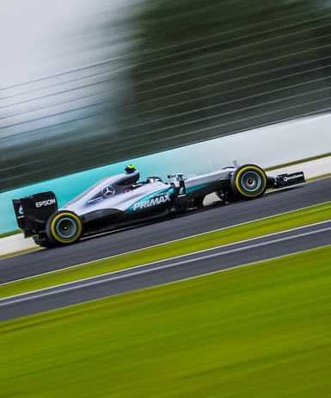
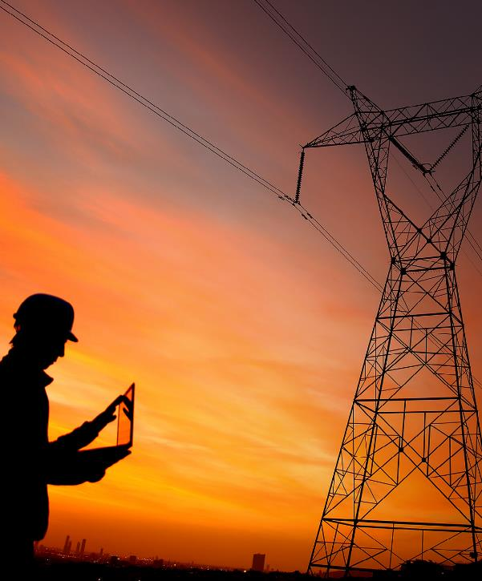
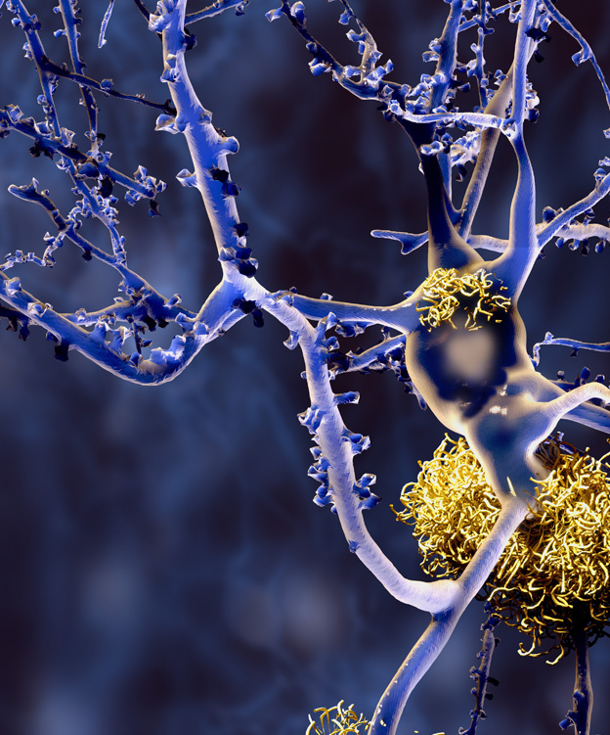



HPE is powering AI in different industries
Using AI to perfect race strategy
Leveraging 2.3 million smart meters
to fix power outages faster
Accelerating Alzheimer’s research
100x using in-memory analytics
Notes:
Here are some examples of customers HPE has already helped.
Mercedes F1 is using AI to perfect their race strategy
Seagate is using deep learning image recognition running on Edgeline systems to improve manufacturing yield
DZNE accelerated their Alzheimer’s research 100x using in-memory analytics
Sources:
-HPE Newsroom – AMG Petronas: https://news.hpe.com/mercedes-amg-petronas-motorsport-partners-with-hewlett-packard-enterprise-to-accelerate-performance-through-new-technology-solutions/
-Seagate: https://www.youtube.com/watch?v=TPf0qC7itcA
-DZNE: https://www.hpe.com/us/en/customer-case-studies/dzne-memory-driven.html

Slide 15
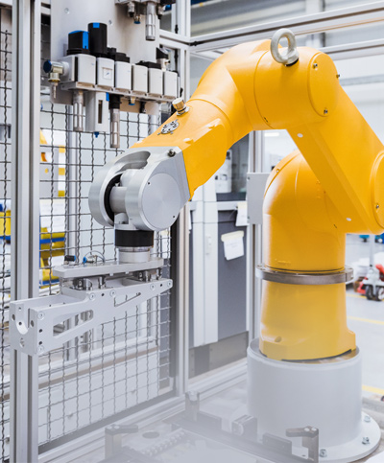
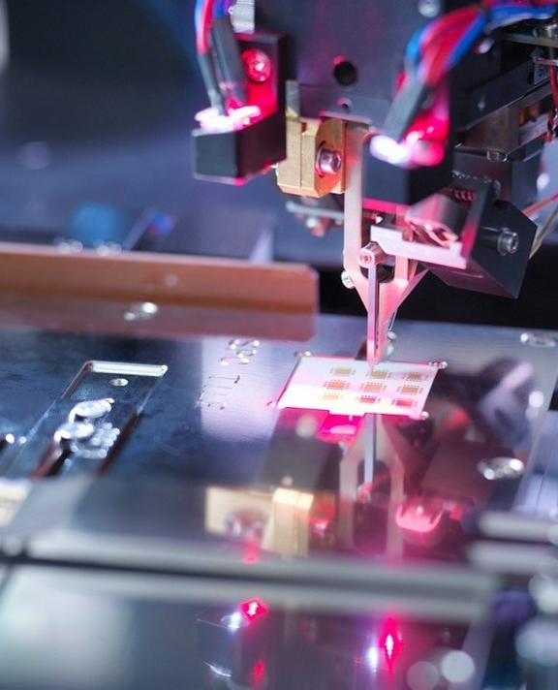
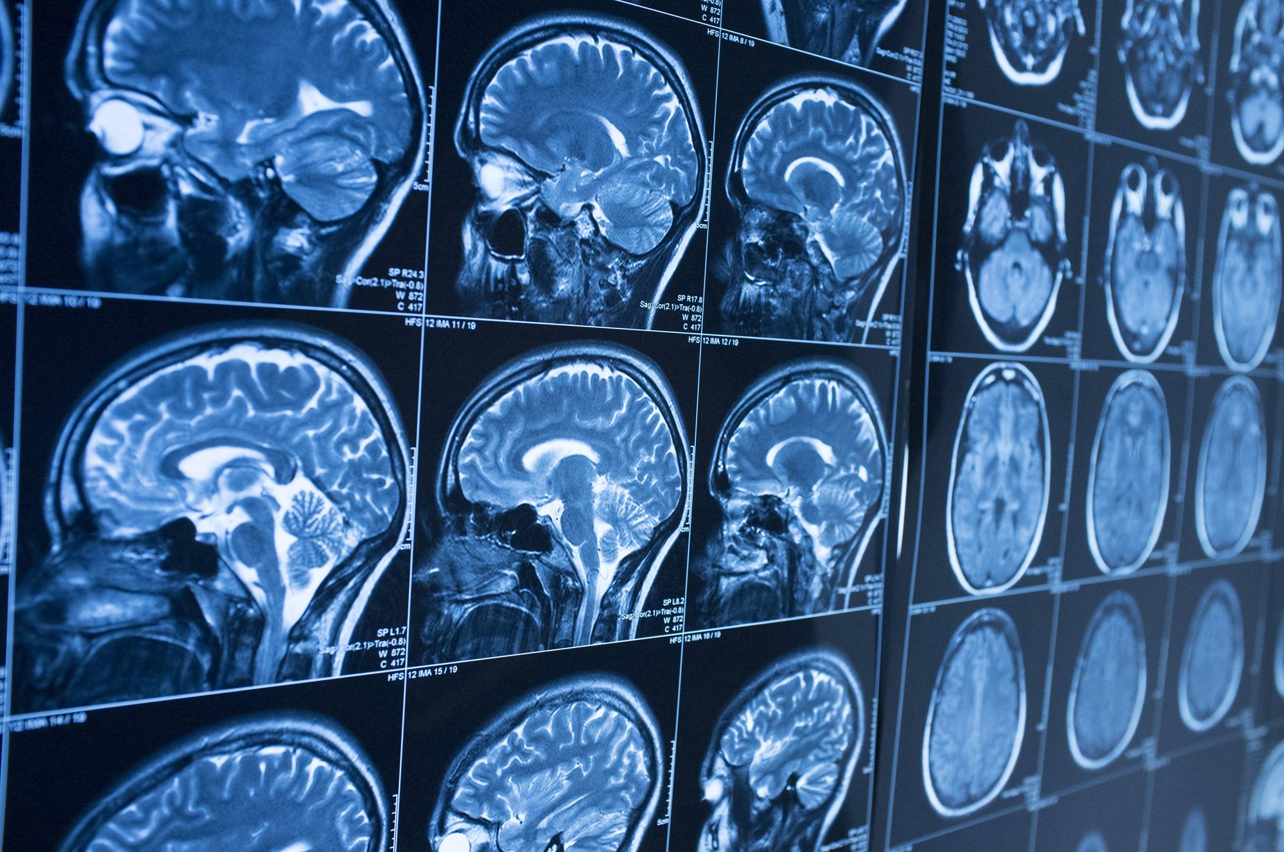



Providing solutions for tried-and-true analytics
Knowing when a machine will fail
before it disrupts production
Converging AI, IT and OT
to boost output and quality
AI data platforms to manage Exponential Growth of Medical Imaging
Notes:
If you already know how to extract meaning from your data then you can use tried-and-true analytics technique. (Although you may need more computational muscle to get the job done in “decision time”)
ABB uses distributed analytics to brings intelligence to industrial plants
CenterPoint Energy brings data into every decision with HANA and Hadoop
Sauber is a computational fluid dynamics use case that needs HPC horsepower
Sources:
-ABB: https://www.youtube.com/watch?v=VSwy3m4T554
-Centerpoint: https://www.hpe.com/us/en/customer-case-studies/centerpoint-energy-smart.html
-Sauber F1 Team: https://www.youtube.com/watch?v=Njq3SRO3Q0M

Slide 16
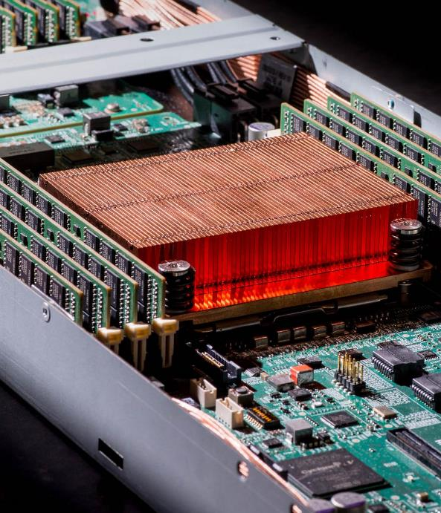
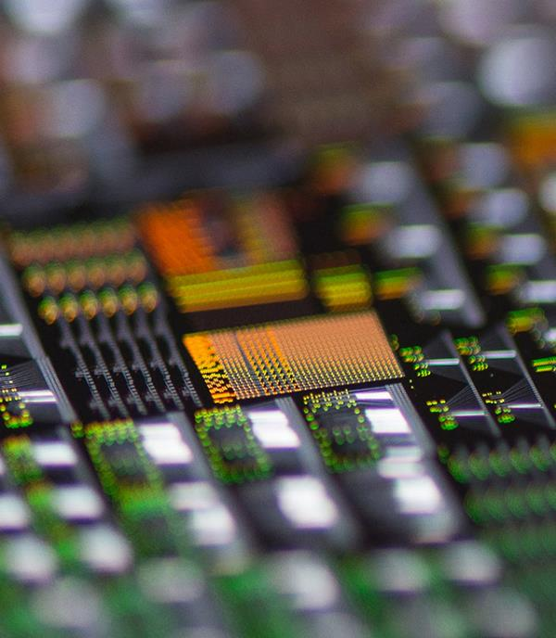
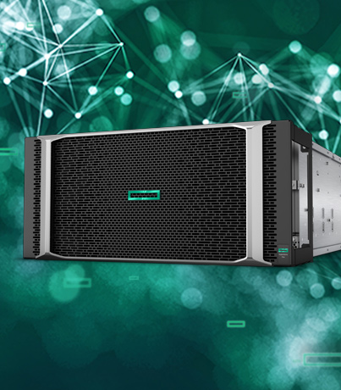
HPE is at the forefront of what’s next for data
Memory-Driven Computing
Ultimate composable infrastructure
High-performance computing
From the enterprise to exascale
In-memory analytics
Extreme scale-up computing
Investing, partnering, and inventing new forms of computing to power an AI-driven world
Notes:
And we have a technology vision for the future. The data explosion isn’t going to slow down, and neither are opportunities to gain competitive advantage.
We are investing, partnering and inventing new forms of computing to power an AI-driven world. Advancing our leadership in HPC, large-memory architectures and our advanced research in Memory-Driven Computing, HPE is at the forefront of what’s next for data.
New ways to accelerate the automation of model deployment and orchestration along the continuum between edge and cloud.
Constantly innovating in economics, looking for new ways to de-risk customers’ most ambitious project.

Slide 17



Wherever you are on your AI journey, HPE can help
Explore
HPE Artificial Intelligence
Transformation Workshop
HPE AI/ Deep learning Trainings
Experiment
HPE Digital Prescriptive Maintenance
Proof of Value
HPE Agile AI Design and Planning Service
Evolve
HPE GreenLake
HPE Big Data/ AI Implementation
Integrate AI to the existing applications
Gather and validate your use cases and data
Align teams around common vision & plan
Conduct a Proof-of-Value for select use cases
Manage change, train your teams and AI systems
Understand AI, data, analytics outcomes and challenges
Protect, manage and consume data and analytics
Modernize data, compute, storage platforms
Explore the best use cases and technologies
Notes:
This is our methodology for customer who are just beginning their AI journeys.
Start with Pointnext workshops and training.
- Understand outcomes and challenges AI brings, may be have someone from your IT team and organization focus and learn more about AI and engage outside experts to help with this initial phase
Align your teams by grounding them on common AI terminology and understanding
Select the best use cases. Ideally, for machine learning you may want to look for candidates with available data to train your system.
This kind of initiatives often fail due to lack of business interlock, coming from a more technology based approach. By not supporting the business objectives, such a solution is at the risk of not being used. Once started data access delays are also a factor that increases risk of delays.
Then start experimenting:
Identify the data sources that will be required for the use case and high-level roadmap for use case implementation
Deliver a Proof-of-Value as it would be deployed into a production environment
Test and validate the outcome of the PoV and data.
Don’t just leave it at this experimentation stage. Evolve and scale.
HPE Greenlake consumption models make this easy.

Slide 18

Grazie mauro.colombo@hpe.com
Notes:
Thank you for attending todays training and looking forward to watching your success grow in the world of AI.
And now, I would like to open it up to questions and answers.

